Slide 1

Programing
Sasha Nicolas Dolgopolyy, Raphaël Fontaine, Charles-Antoine Pare, Emile Riberdy

Slide 2




équipe
Raphaël Fontaine
Émile Riberdy
Charles-Antoine Paré
Sasha Nicolas Dolgopolyy

Slide 3
Agenda
Data Cleaning
Algorithms
1
2
Visualization
Questions
3
4

Slide 4
1. Data Cleaning

Slide 5
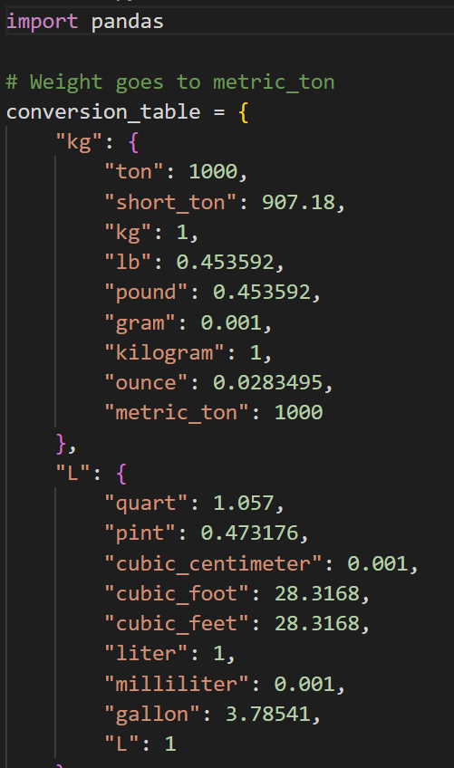
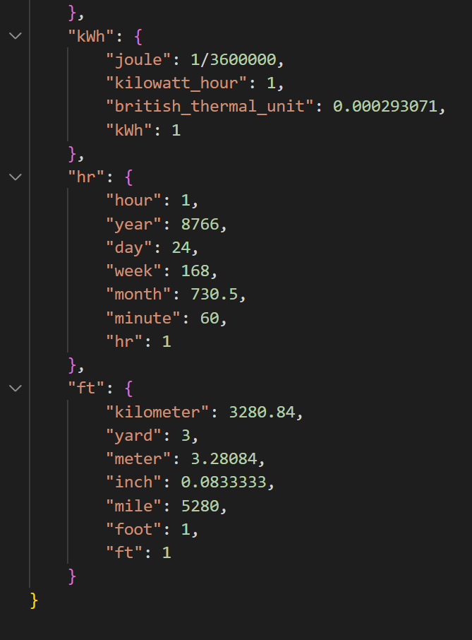
Conversion Tables

Slide 6
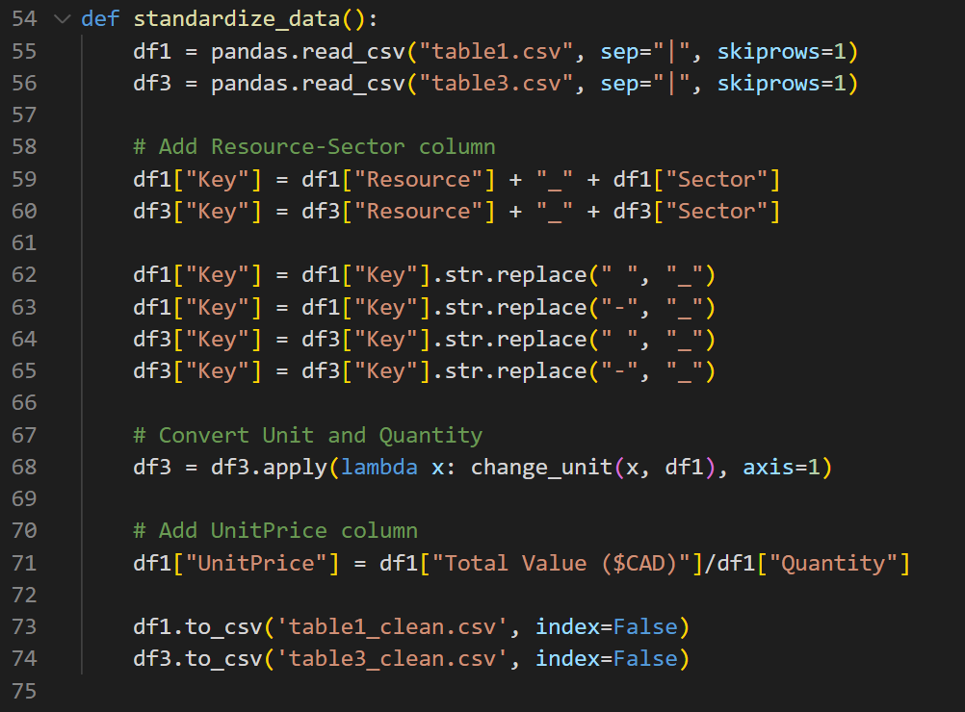
Standardized Data

Slide 7
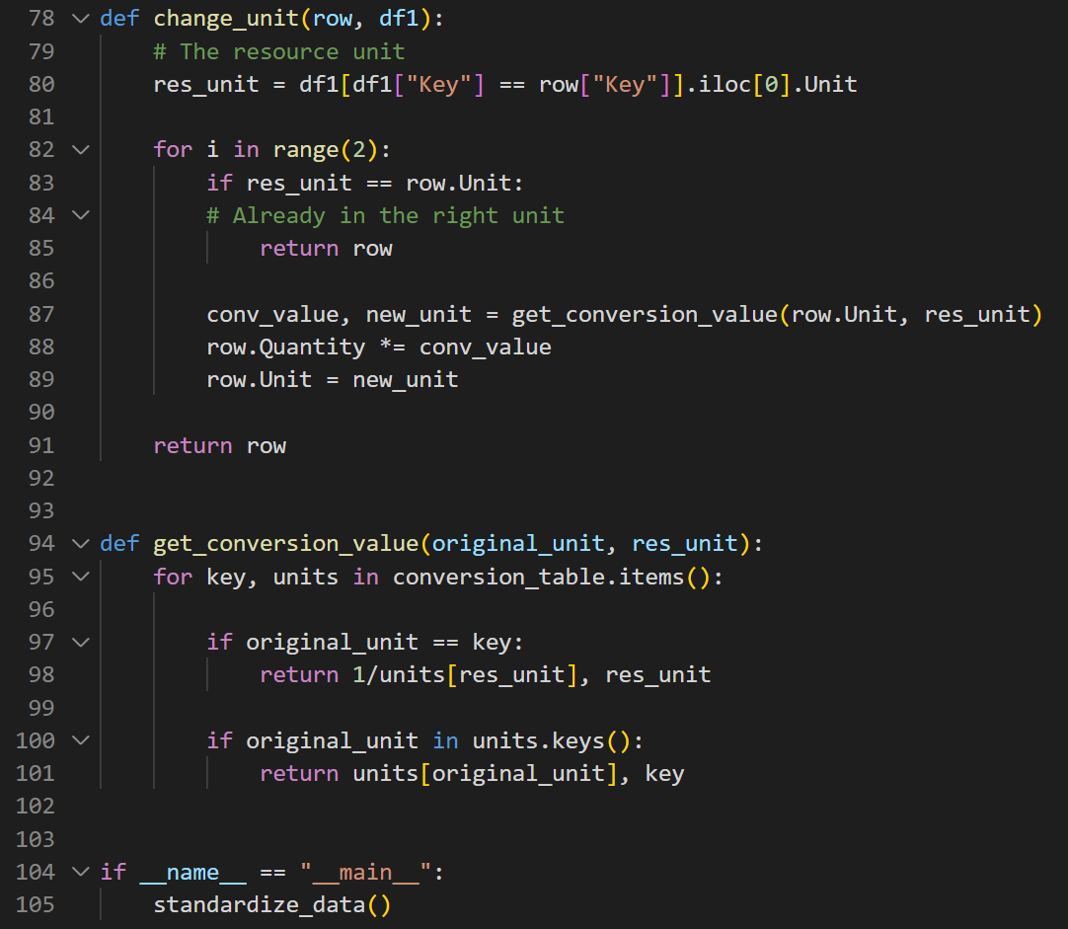
Unit Change

Slide 8
2. Algorithms

Slide 9
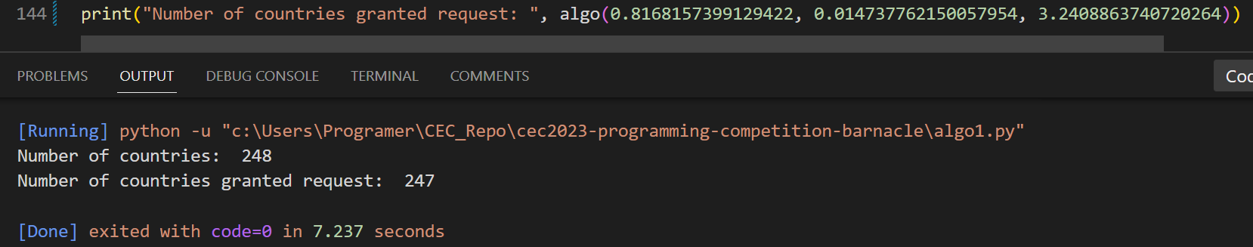
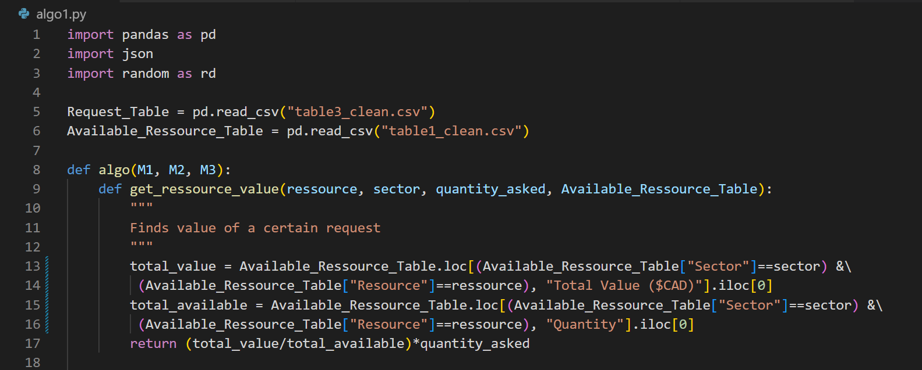
Algorithm 1
RESULTS
247 countries out of 248 had a request granted ​
Weighted algorithm
Give a scarcity value to each request from each country
Scarcity variables:
+Total ask/Total availability
0.8168157399129422
+Ask as a % of total availability (between 0 and 1)
0.014737762150057954
-Number of request by country
3.2408863740720264
Assign least scarce request
Helper function to find monetary value

Slide 10
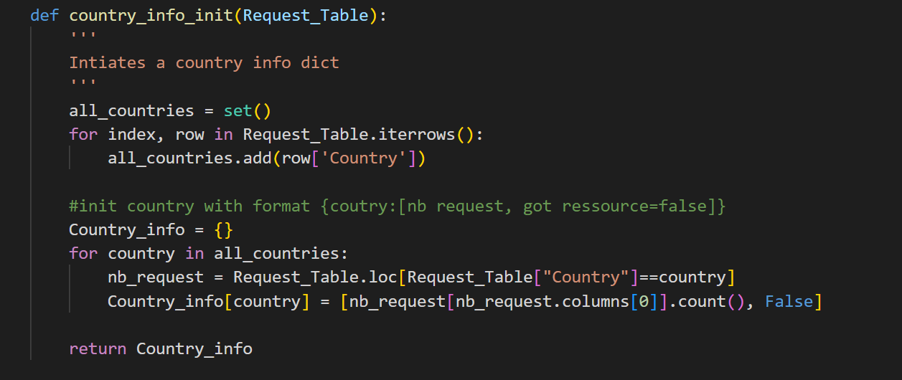
Create Dict with Country info

Slide 11
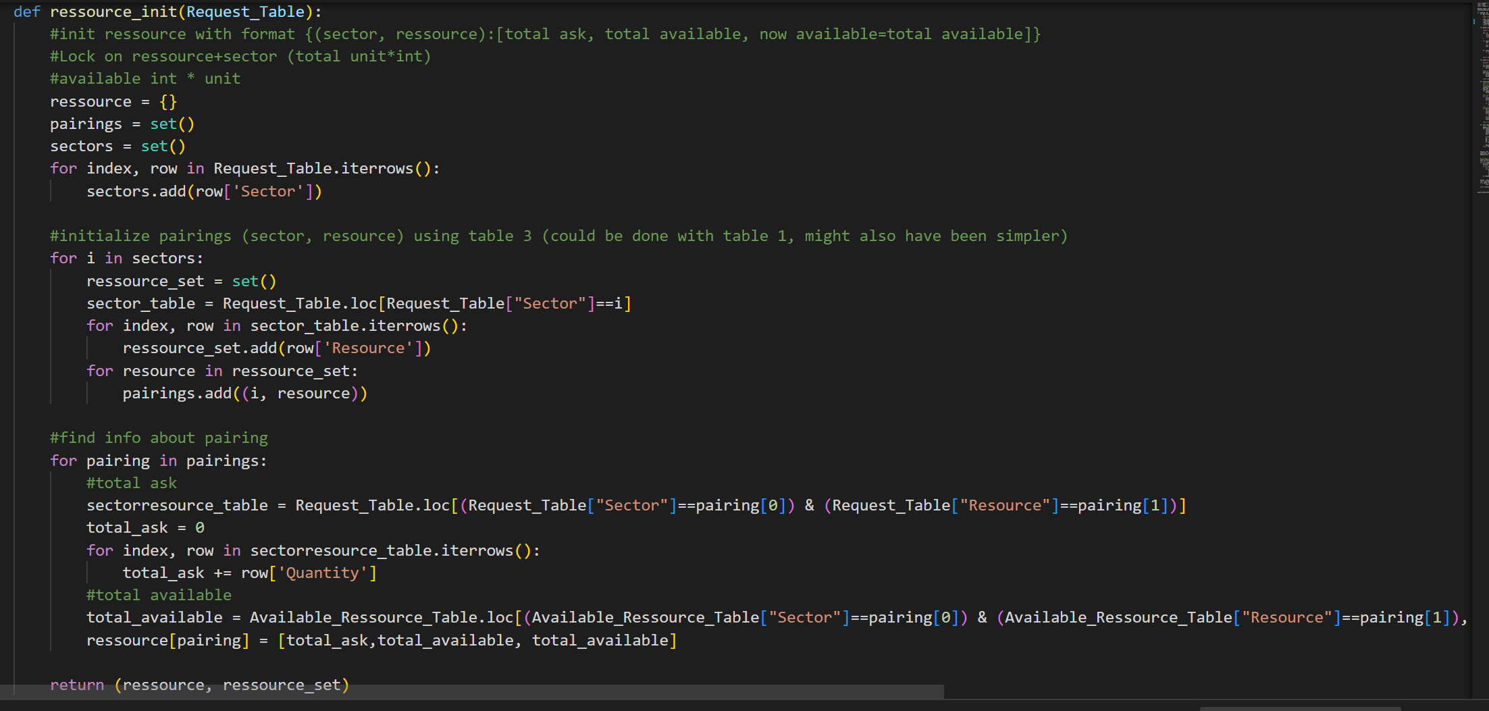
Create a Dict with All Requests

Slide 12
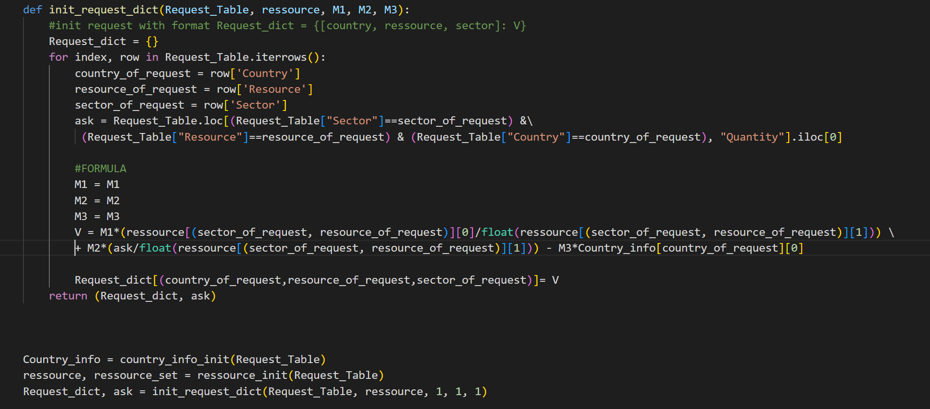
Assign Weight to Resource

Slide 13
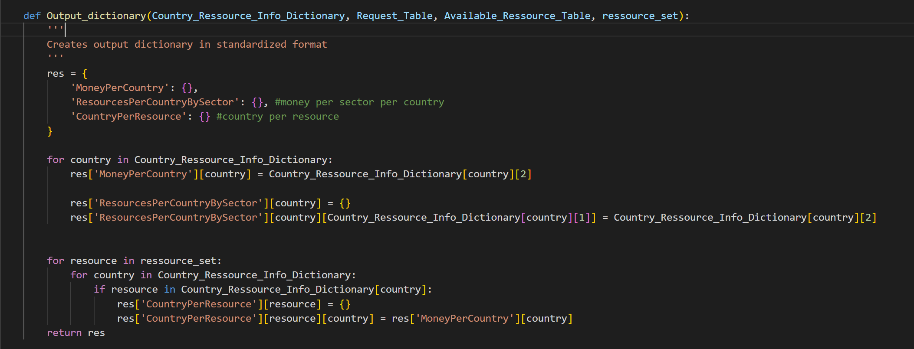
Generating the Standardized Output

Slide 14
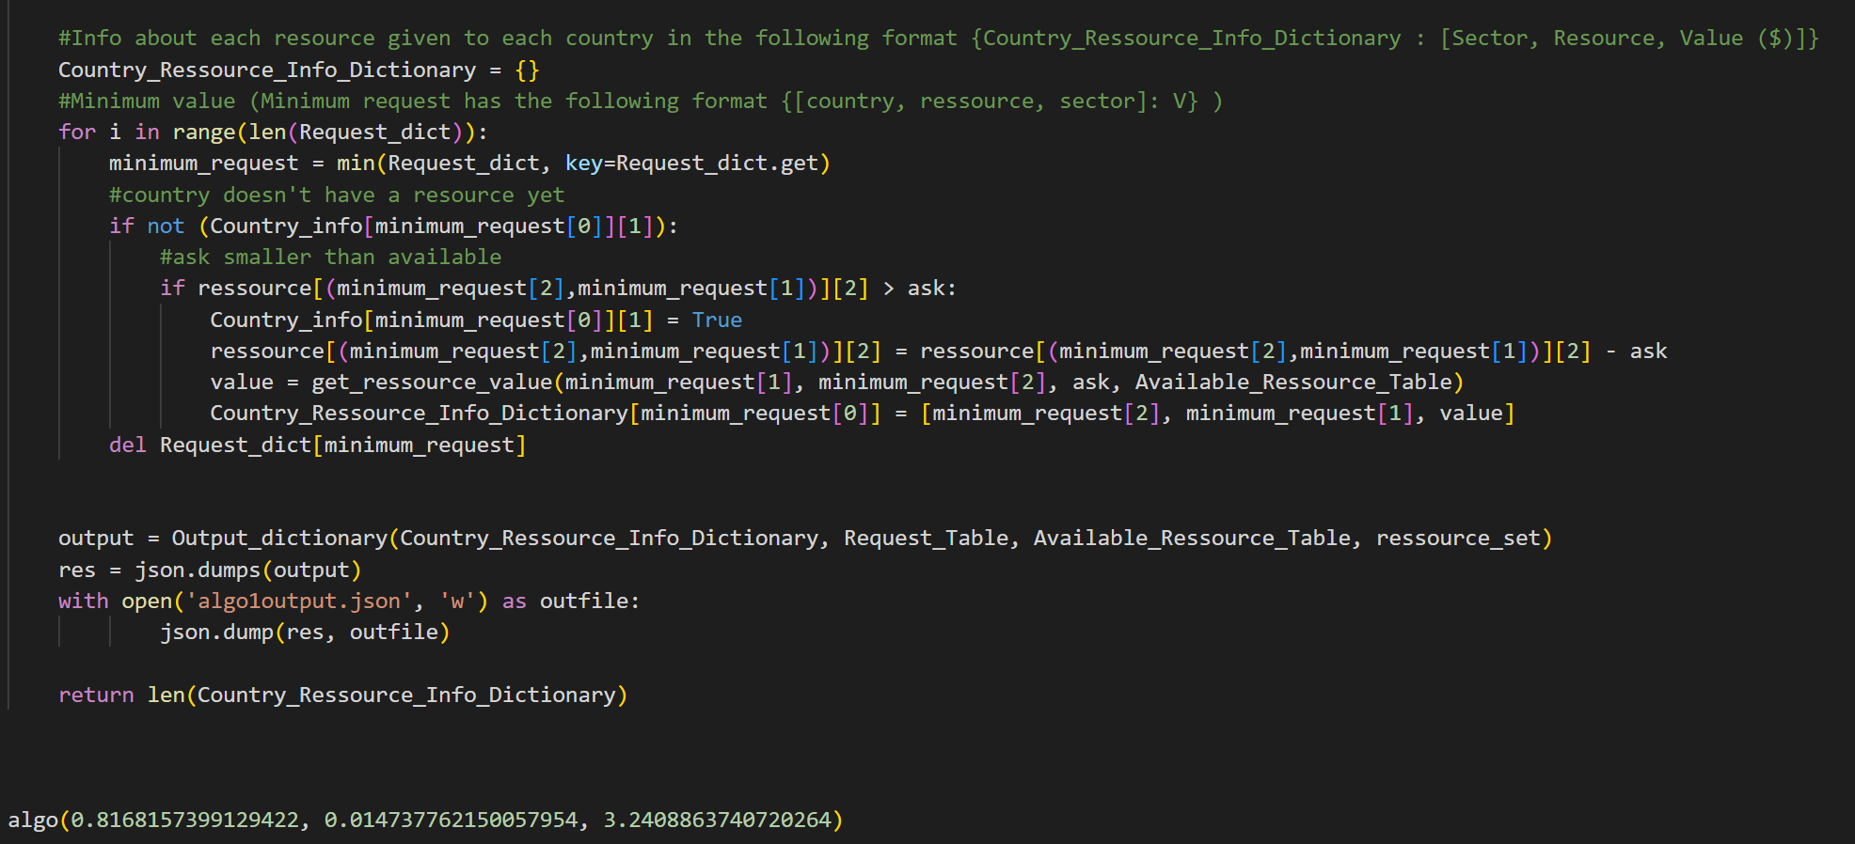
Build Resource Allocation Dict

Slide 15
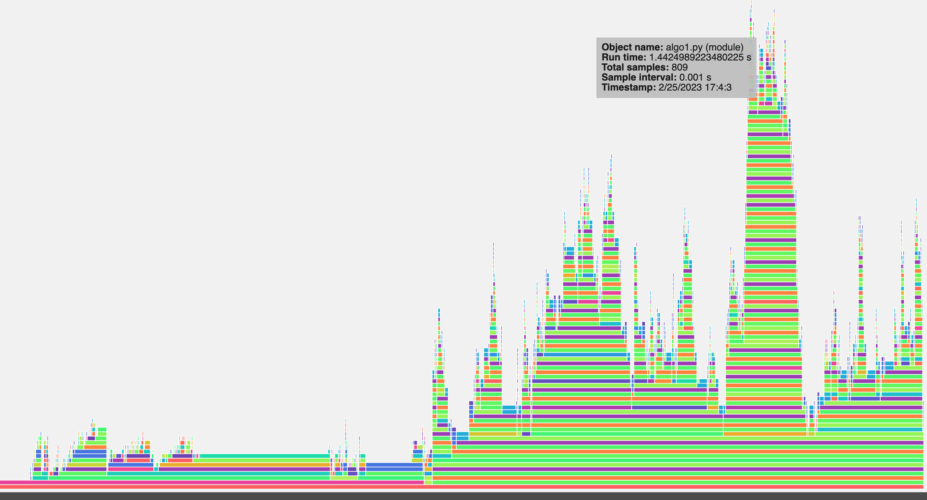
Algorithm 1 CPU & RAM Usage (1)

Slide 16
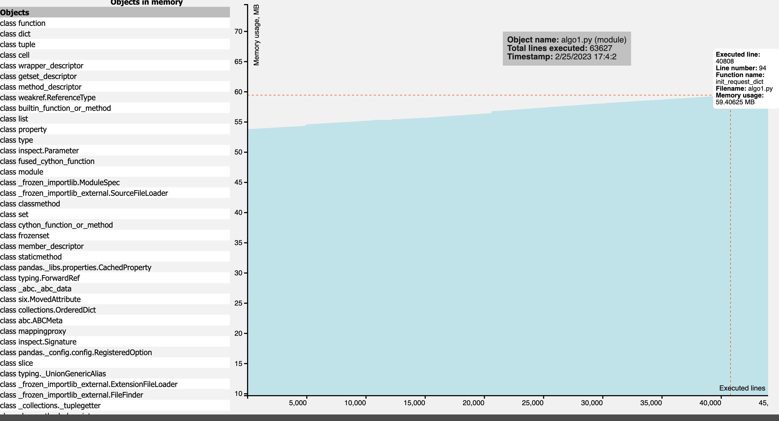
Algorithm 1 CPU & RAM Usage (2)

Slide 17
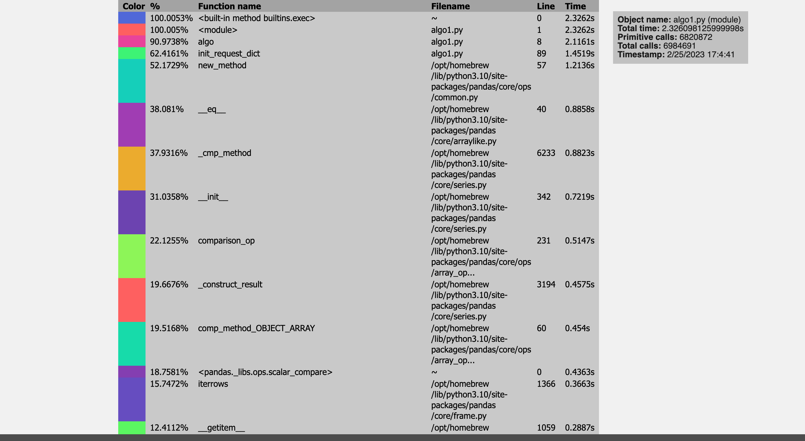
Algorithm 1 CPU & RAM Usage (3)

Slide 18
Algorithm 2
Linear Programming (Maximization)
Main Constraints:
The number of resources allocated to a country is upper bounded by this country's request for this resource
For each resource, the sum of the donations to each country is less than or equal to the total quantity available
Each country must receive the same monetary value in donation
Implemented using python PuLP (Linear Problem Solver)
Each linear variables is analogous to the quantity of a certain material given to a country
Each variable is a row in the dataset 3 (Country – Resource – Sector combination)
Solution is the Maximization of the amount of each resource given to each country while following the constraints

Slide 19
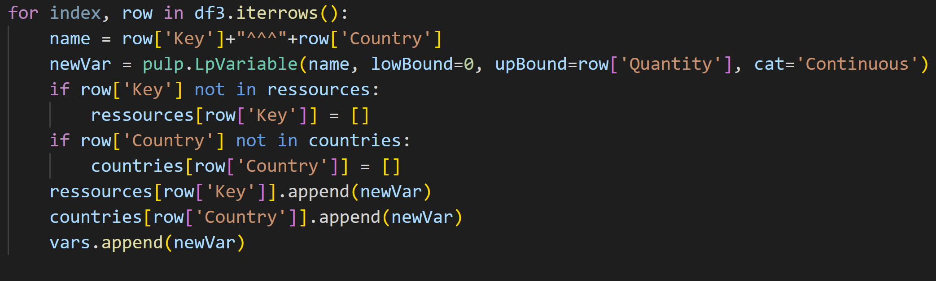
Algorithm 2 – Variable Creation
Pseudocode:
Create Variable (Name: Resource – Sector – Country combination)
Append to list of similar resource (Resource – Sector pair)
Append to list of resources for specific Country

Slide 20
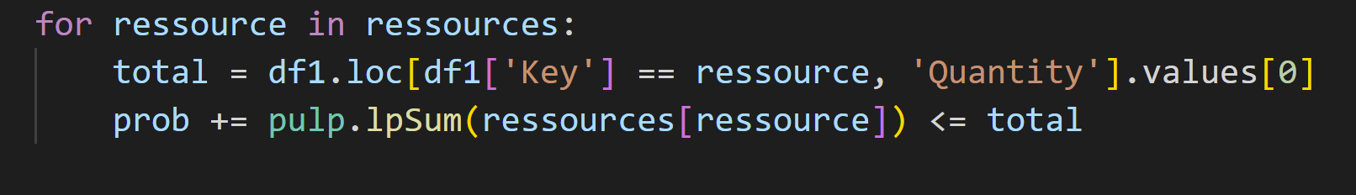
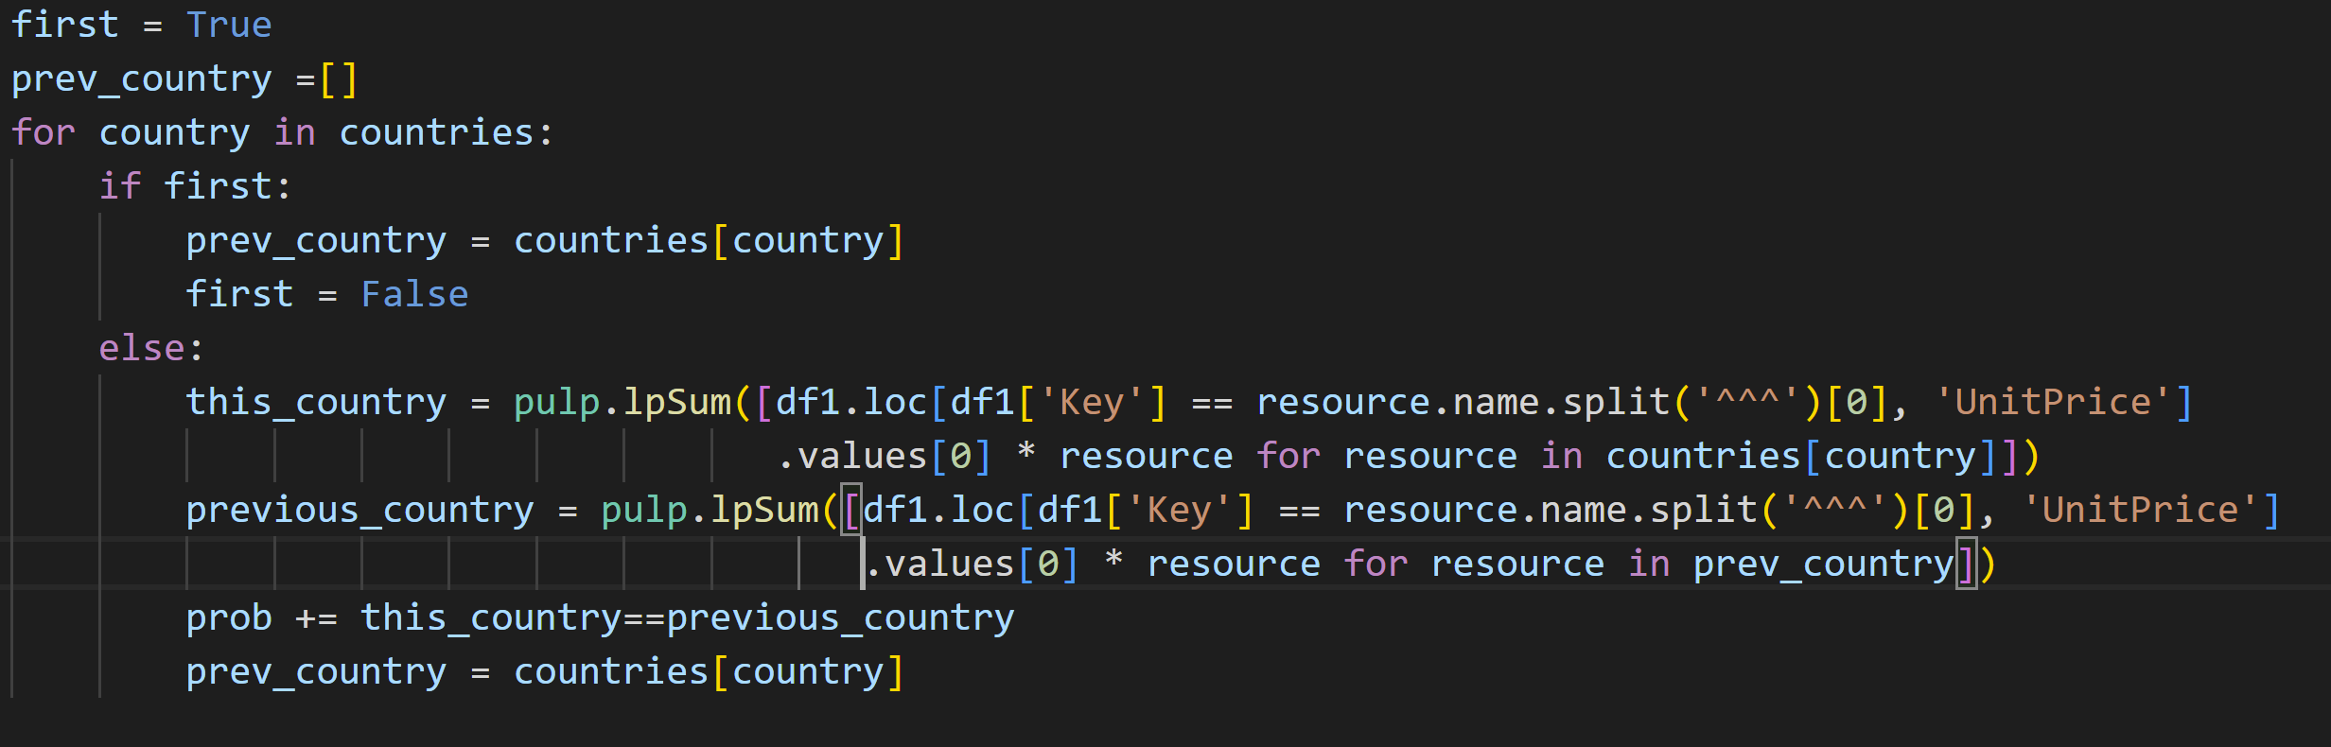
Algorithm 2 – Main Constraints
Equality Chain:
Country1 == Country2
Country2 == Country3
. . .
Country(n-1) == Country(n)

Slide 21
Algorithm 2 - Result
Each Country receives 188.24 $CAD worth of resources
This is the value of the resources requested by Ireland
Country | Resource | Quantity | Unit | Sector
-------------------------------------------------------------------
Ireland | Bioenergy | 1448 | kWh | Energy
1448kWh of Energy-Bioenergy * 0.13CAD$/kwH of Energy-Bioenergy = 188.24 CAD$

Slide 22
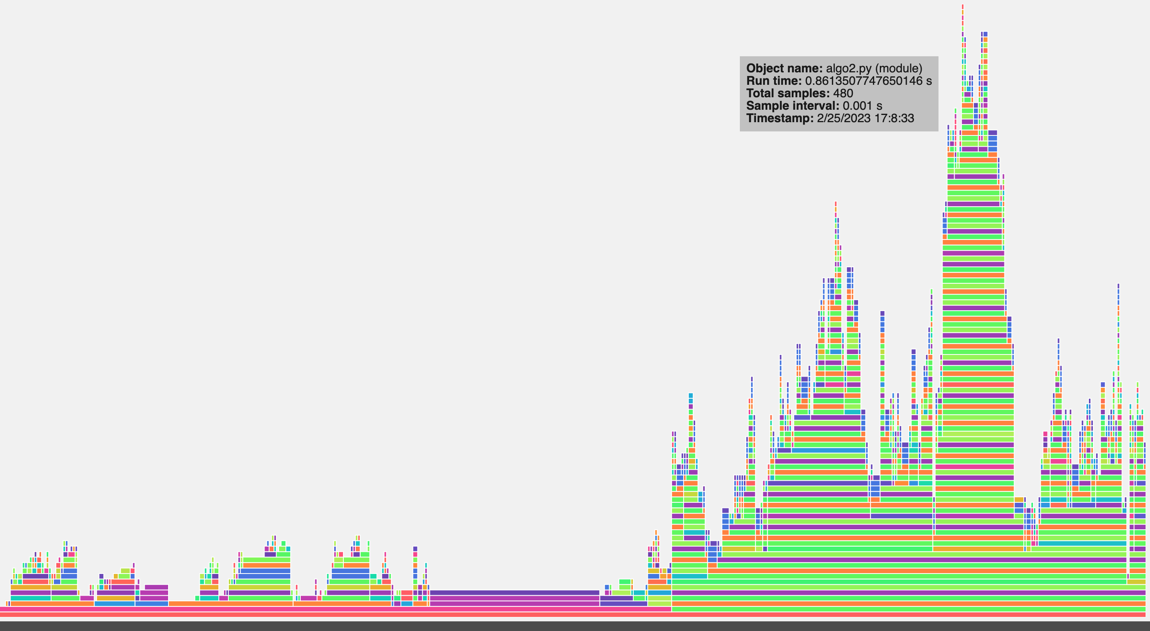
Algorithm 2 - CPU & RAM Usage (1)

Slide 23
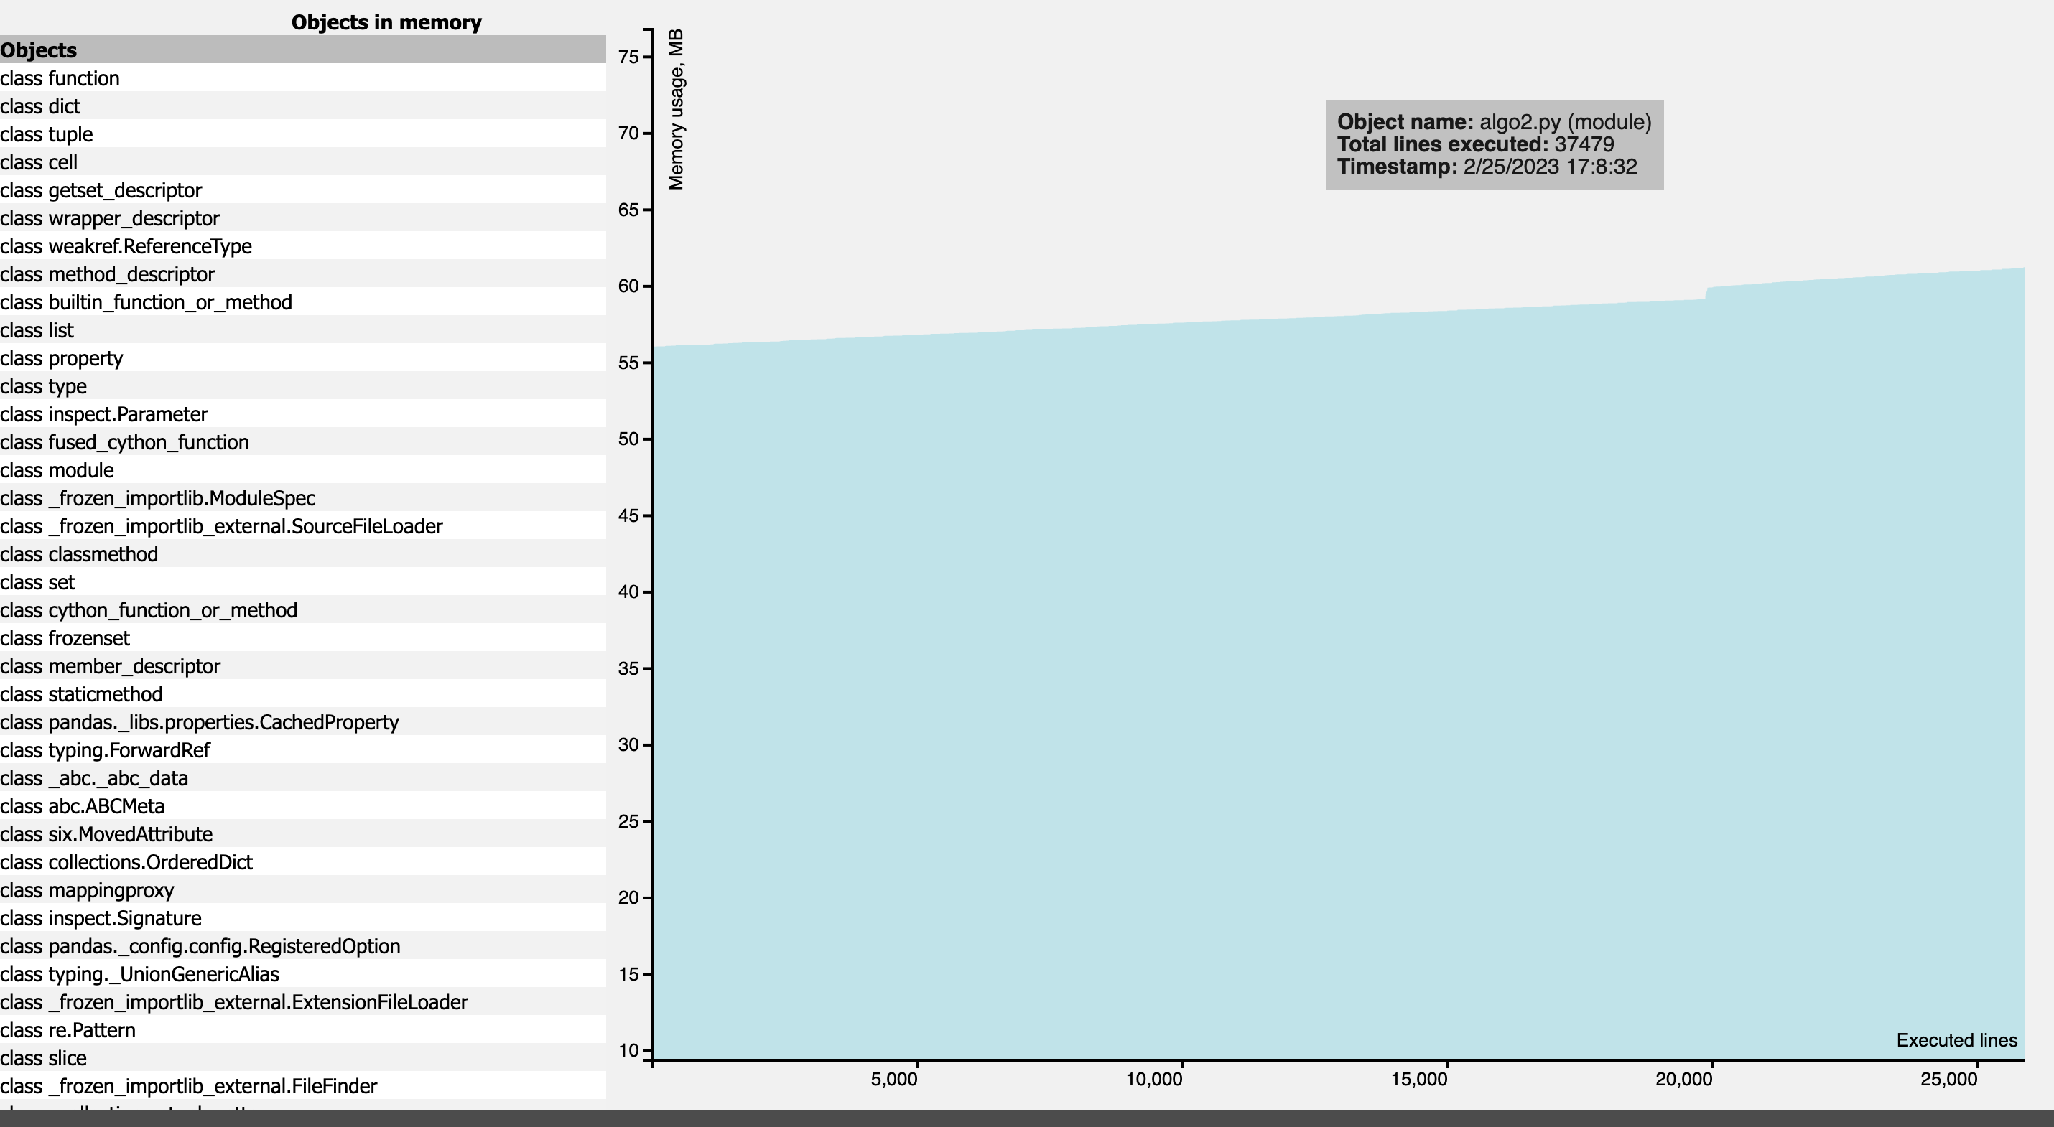
Algorithm 2 - CPU & RAM Usage (2)

Slide 24
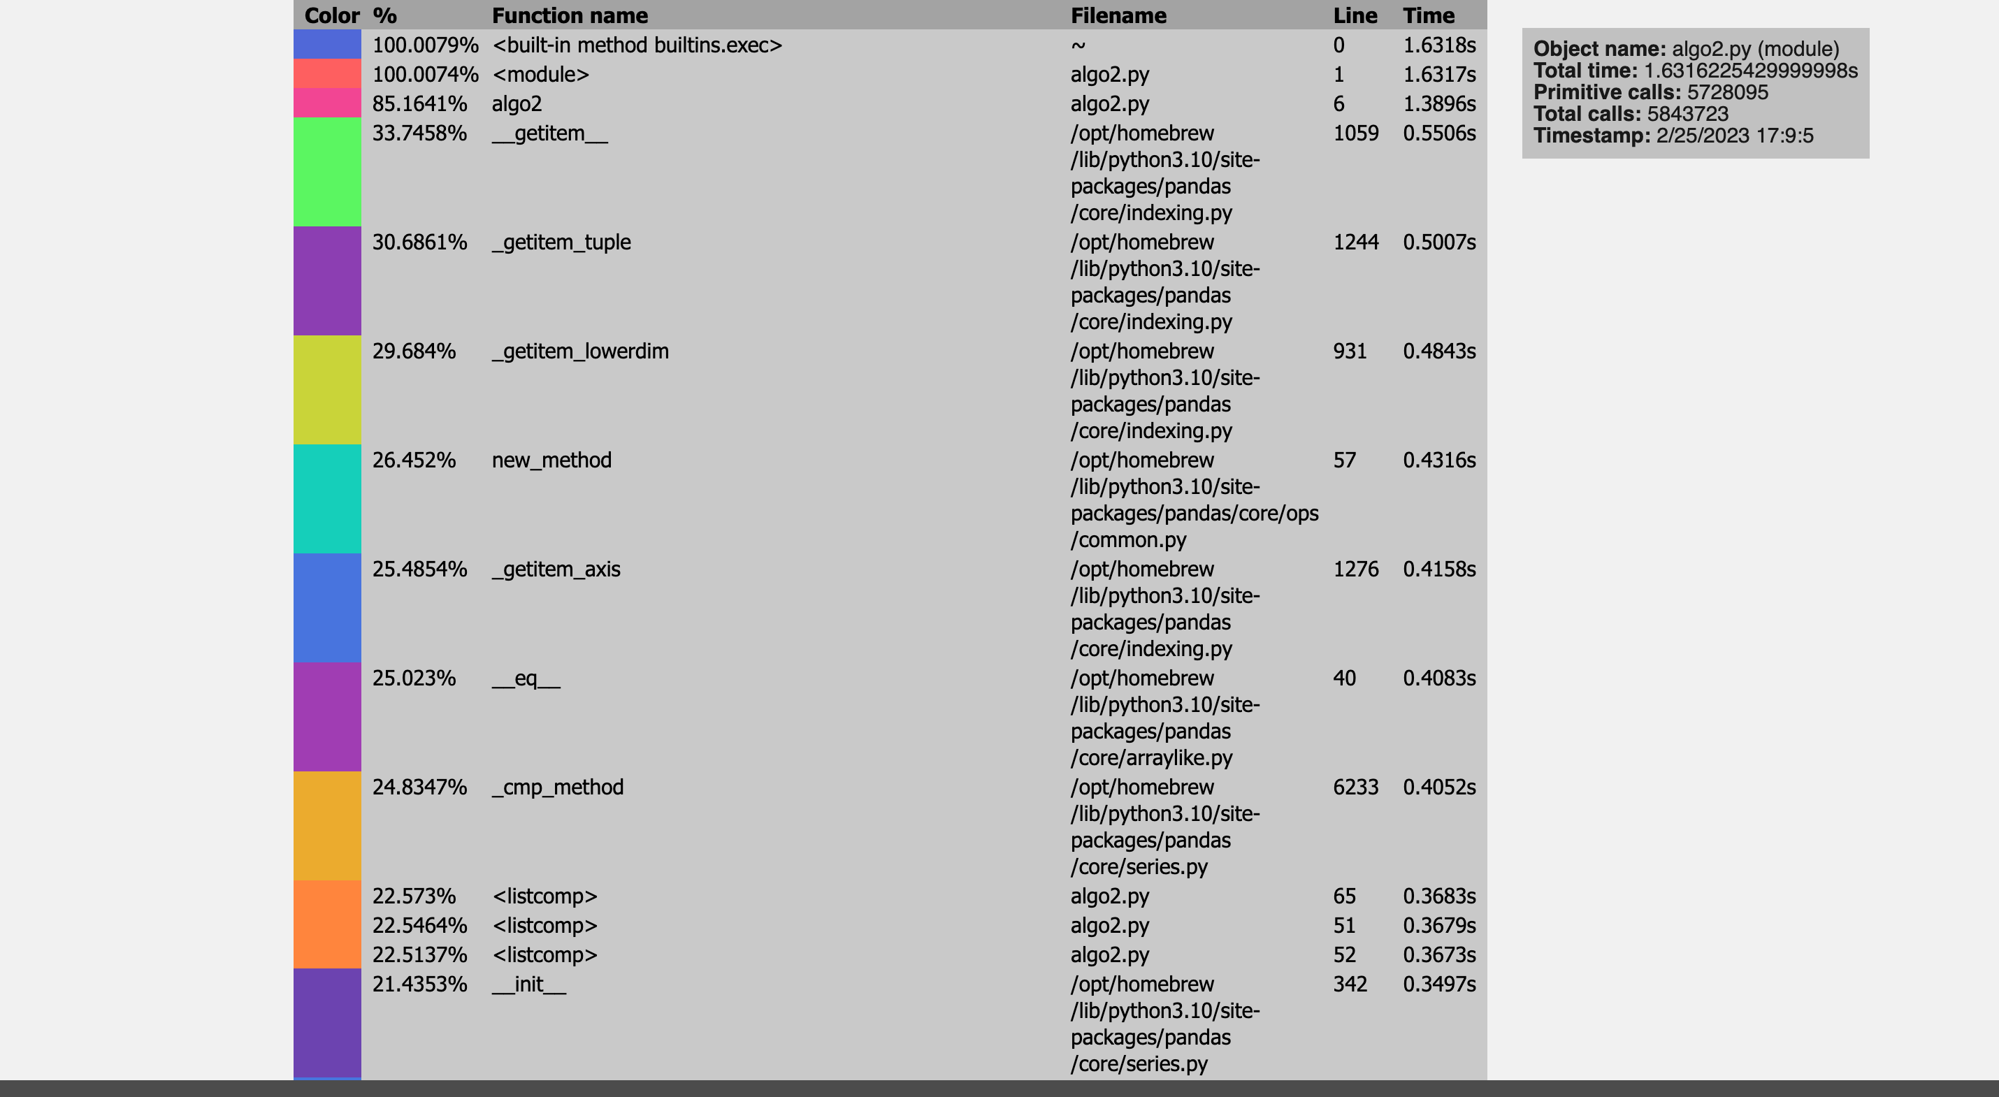
Algorithm 2 - CPU & RAM Usage (3)

Slide 25
Algorithm 3
Linear Programming (Maximization)
Objective function: Maximization of the ratio between the donation and donation target for each country
Main Constraints:
The number of resources allocated to a country is upper bounded by this country's request for this resource
For each resource, the sum of the donations to each country is less than or equal to the total quantity available
The donation for a country cannot exceed the country's target donation
Implemented using python PuLP (Linear Problem Solver)
Each linear variables is analogous to the quantity of a certain material given to a country
Each variable is a row in the dataset 3 (Country – Resource – Sector combination)
Solution is the Maximization of the amount of each resource given to each country while following the constraints

Slide 26
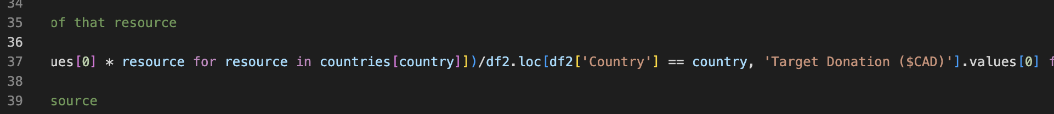
Algorithm 3 – Ratio Maximization
Given donation
Main Difference With algorithm 2: the objective function is computed based on the individual ratio between the given donation and the target donation for each country
Target Donation

Slide 27
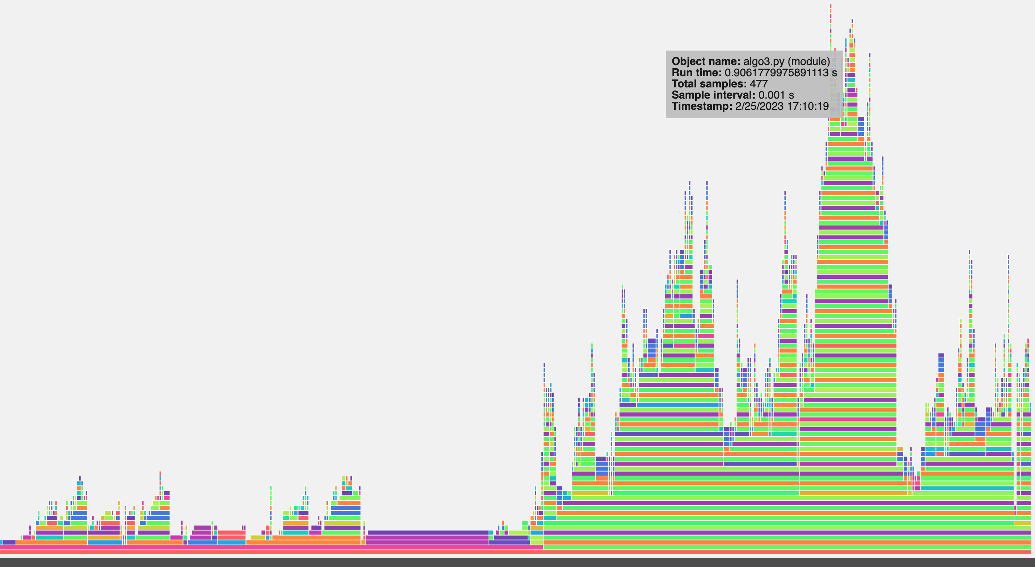
Algorithm 3 - CPU & RAM Usage (1)

Slide 28
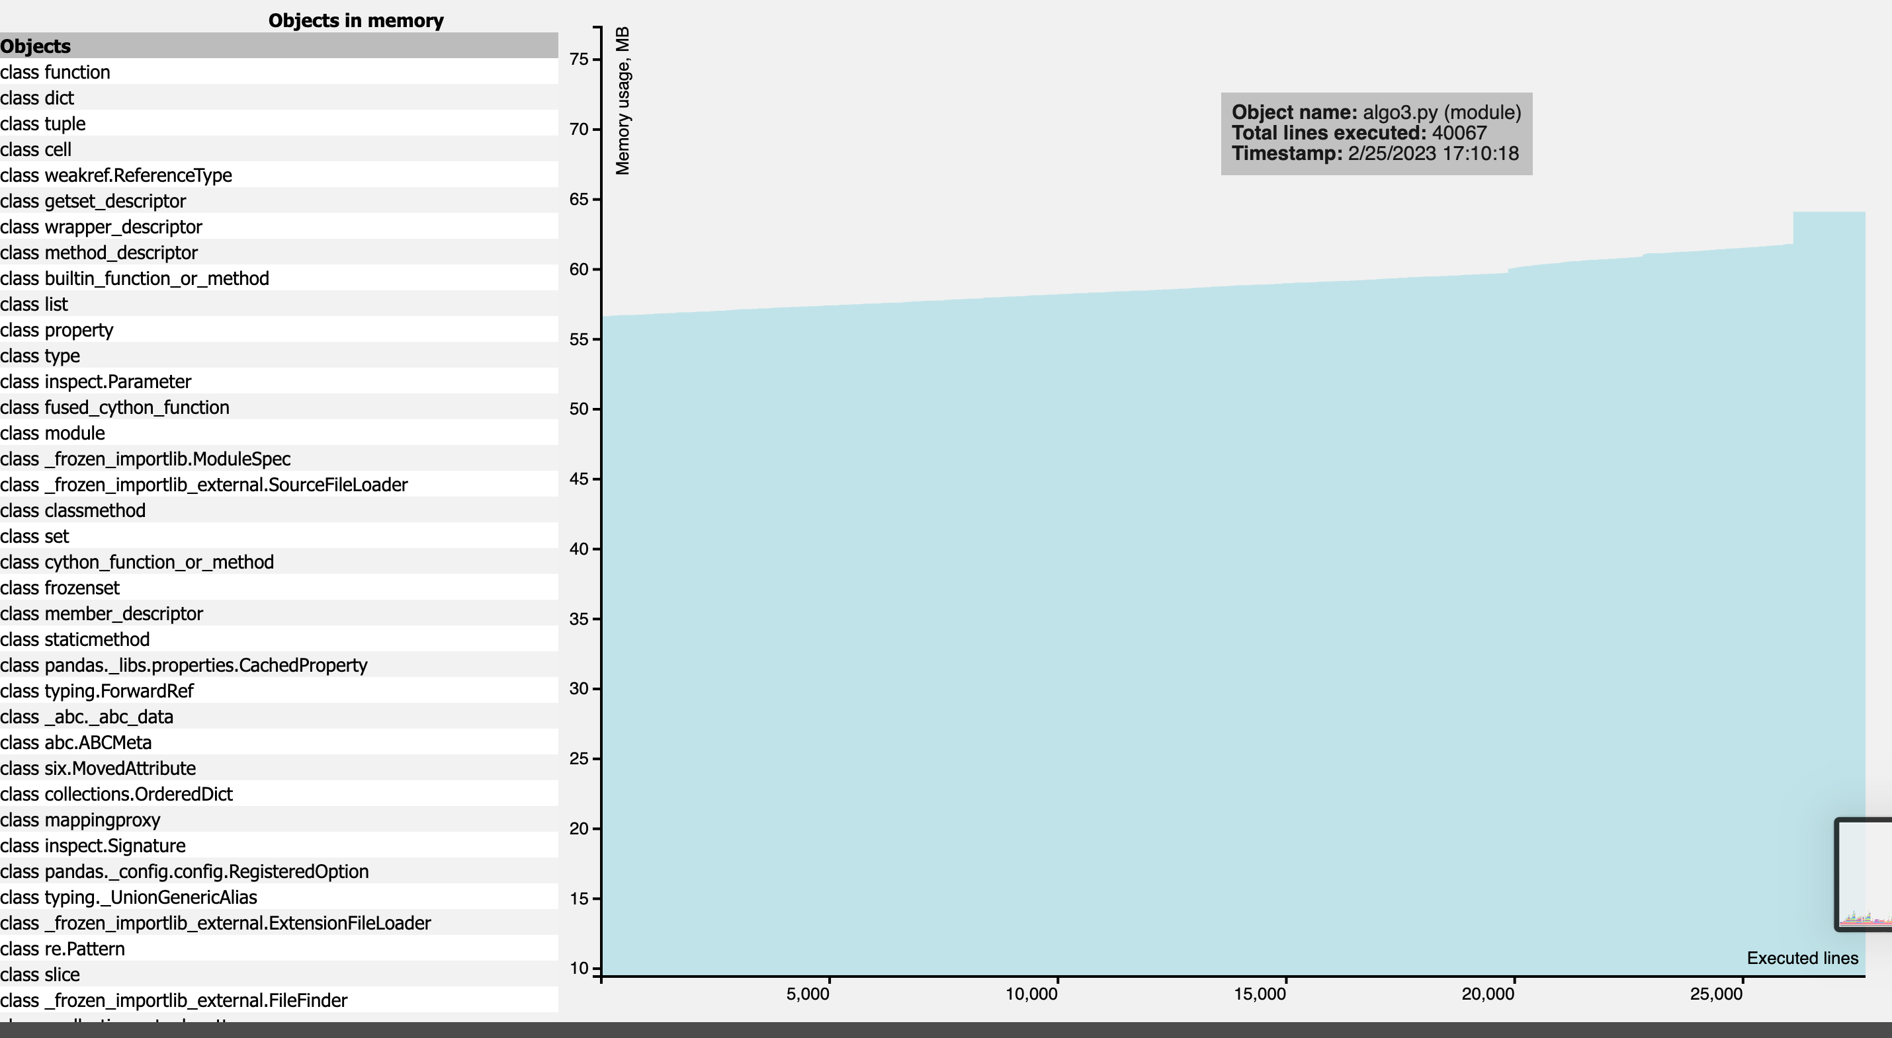
Algorithm 3 - CPU & RAM Usage (2)

Slide 29
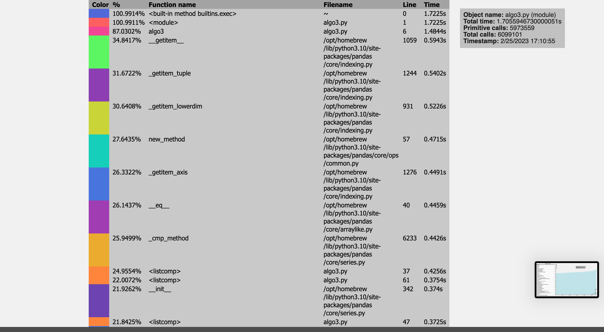
Algorithm 3 - CPU & RAM Usage (3)

Slide 30
Algorithm 4
Linear Programming (Maximization)
Objective function: Maximization of the ratio between the donation and donation target for each country
Main Constraints:
The number of resources allocated to a country is upper bounded by this country's request for this resource
For each resource, the sum of the donations to each country is less than or equal to the total quantity available
The donation for a country cannot exceed the country's target donation
Implemented using python PuLP (Linear Problem Solver)
Each linear variables is analogous to the quantity of a certain material given to a country
Each variable is a row in the dataset 3 (Country – Resource – Sector combination)
Solution is the Maximization of the amount of each resource given to each country while following the constraints
Same concept as for algorithm 3 but linear values are scaled by the Urgency value from table3.csv

Slide 31
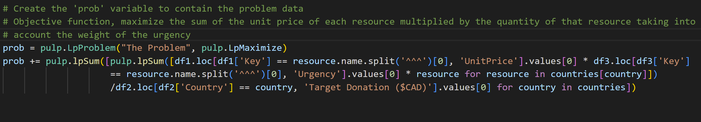
Algorithm 4 – Changes to 3
Adding the weight of the urgency to the Linear problem objective function

Slide 32
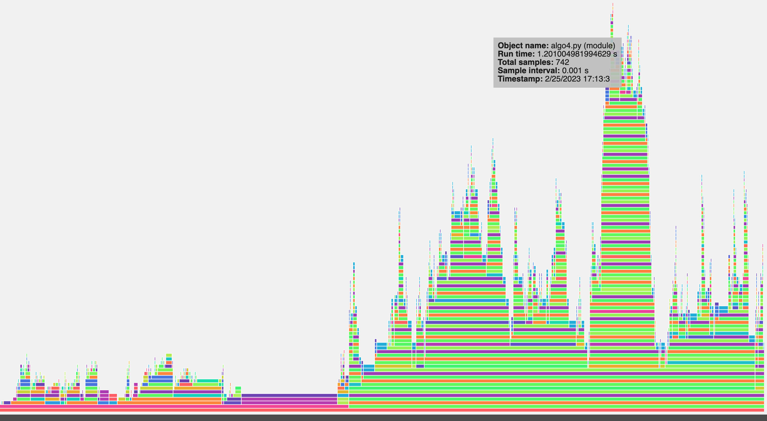
Algorithm 4 - CPU & RAM Usage (1)

Slide 33
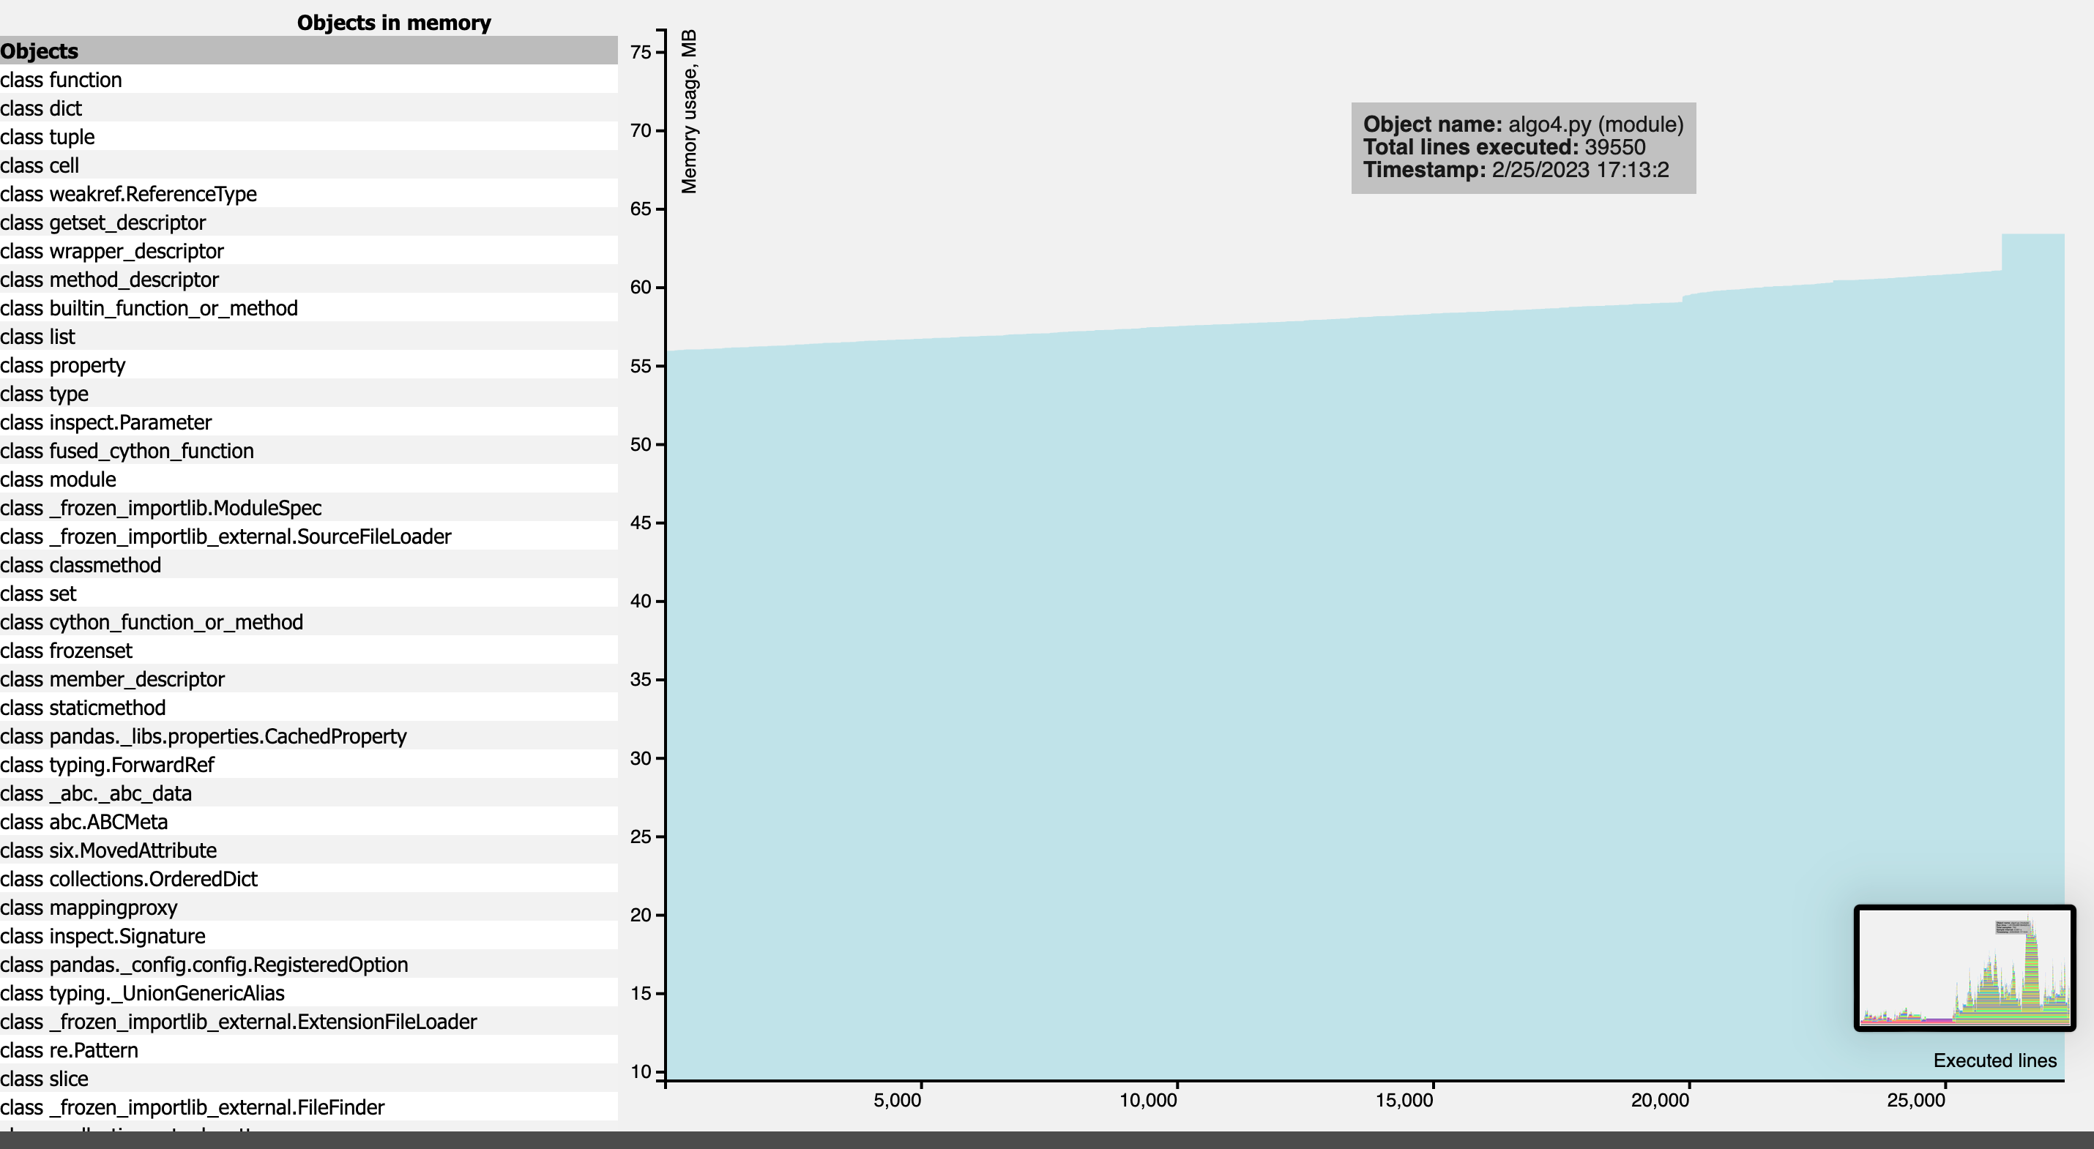
Algorithm 4 - CPU & RAM Usage (2)

Slide 34
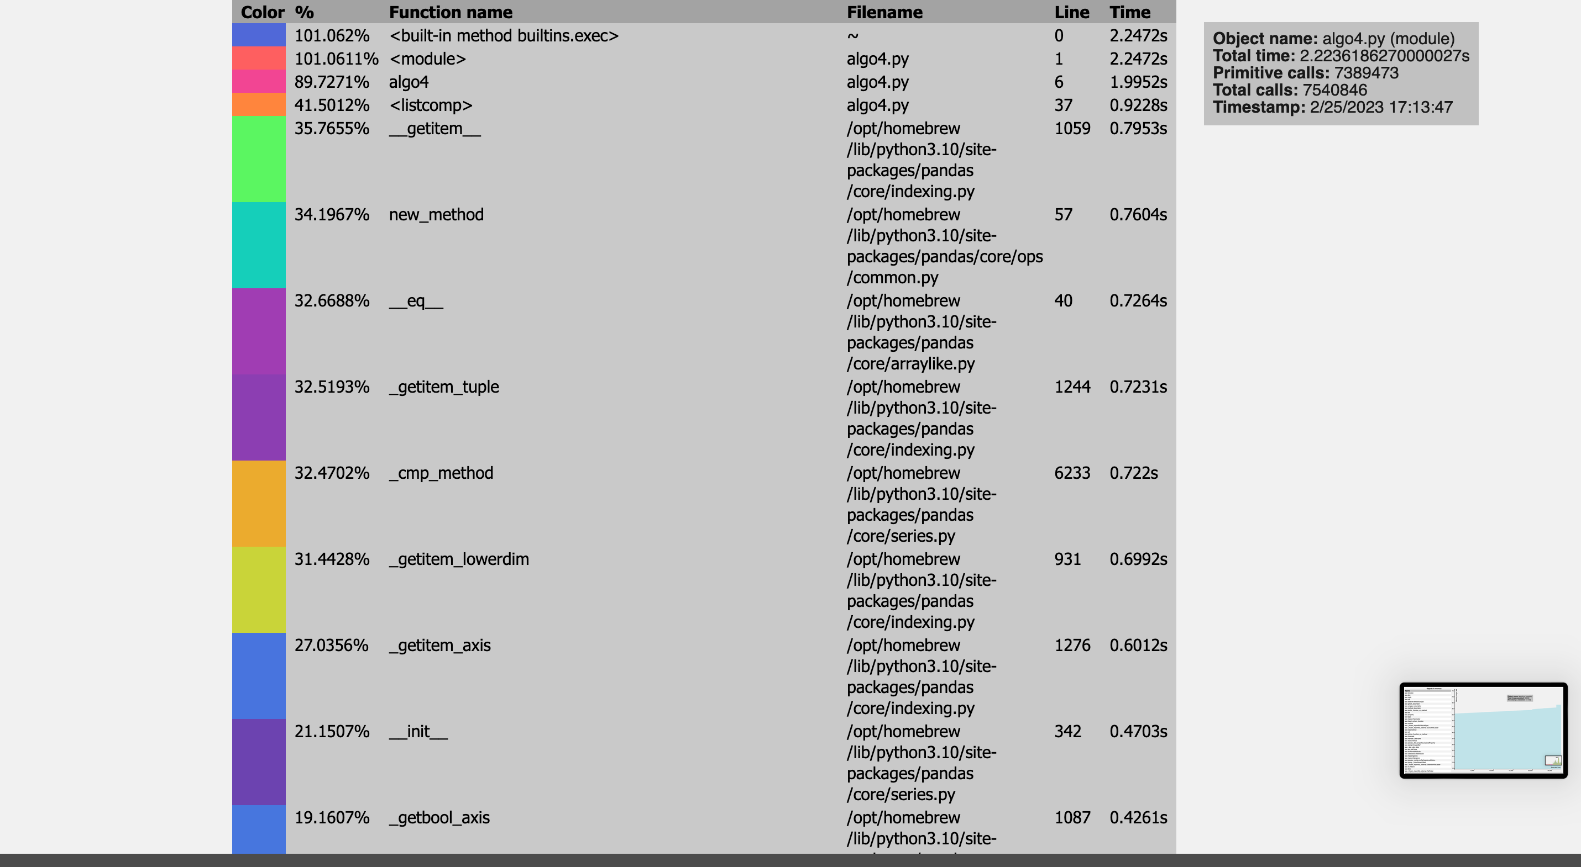
Algorithm 4 - CPU & RAM Usage (3)

Slide 35
3. Visualization

Slide 36
Visualization
Link to frontend app:
https://mcgill.vercel.app/

Slide 37
4. Questions

